Slide 1
Chapter 7
Servlet

Slide 2
Introduction
The way the web applications work is
  Web client like Chrome sends a request using HTTP protocol.
  The server side program takes the HTTP request, processes it and sends a HTTP response back to the web client.
  The response includes body content in HTML format.
  Web client then reads the HTTP response, formats the HTML and displays it to the user.
Since HTTP plays an important role in web applications, let’s first know some basics about it and then look at the server side details.

Slide 3
HTTP
HTTP stands for Hypertext Transfer Protocol.
Following are some of the important properties of HTTP:
  It is a stateless protocol, meaning that every HTTP request is independent of each other.
  It can send data in the request. The server side program reads the data, processes it and sends the response back. This is the most important feature of HTTP, the ability to send data to server side program.
Based on how the data is sent in the request, HTTP requests are categorized into several types, but the most important and widely used are the GET requests and POST requests.

Slide 4
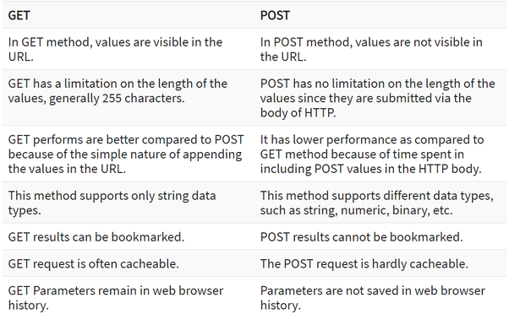
Difference of Get and Post request

Slide 5
Server Side of the Web Application
The server- side is the heart of any web application as it comprises of the following:
  Static resources like HTML files, XML files, Images etc
  Server programs for processing the HTTP requests
  A runtime that executes the server side programs
  A deployment tool for deploying the programs in the server
In order to meet the above requirements, J2EE offers the following:
  Servlet and JSP technology to build server side programs
  Web Container for hosting the server side programs.
  Deployment descriptor which is an XML file used to configure the web application.

Slide 6
Web Container
A Web container is the heart of Java based web application which is a sophisticated program that hosts the server side programs like Servlets.
Once the Servlet programs are deployed in this container, the container is ready to receive HTTP requests and delegate them to the programs that run inside the container.
These programs then process the requests and generate the responses.
Also a single web container can host several web applications.
Look at the following figure that shows how a typical web container looks like:

Slide 7
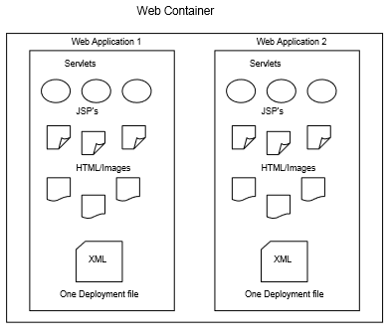

Slide 8
There are several J2EE Web Containers available in the market.
One of the most notable one is the Apache’s Tomcat container which is available for free of cost.
Having just the web container is not sufficient. We need to have a programming model to build server side programs that run within this container.
J2EE supports two key technologies to build server side components in Java. These are Servlet and JSP technologies.

Slide 9
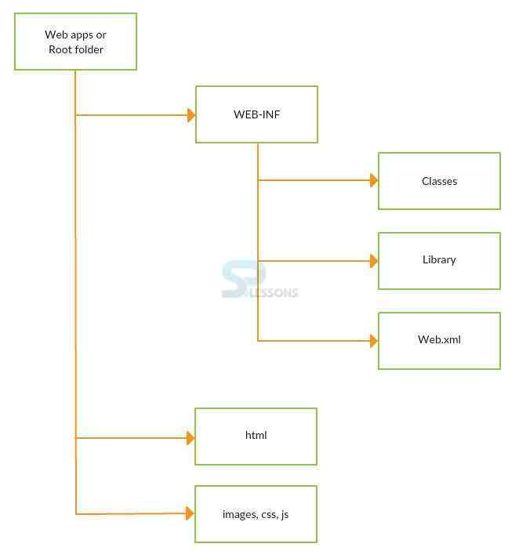
Structure of a Web Application

Slide 10
All the static resources namely html files, image files can be stored directly under myweb directory.
Creating this directory structure is one of the steps in the environment configuration section at the beginning of the chapter.
With the above directory structure, all the components within myweb application should be accessed with the URL starting with:
http://localhost:8080/myweb/
If you want to create another web application like mywebproject, you must again create the same directory structure with mywebproject as the root directory and should access the components using the URL starting with:
http://localhost:8080/mywebproject/

Slide 11
Servlet Technology
Servlet technology is a standard J2EE technology used for building dynamic web applications in Java.
Using Servlet technology is again nothing but using the standard classes and interfaces that it comes with.
These classes and interfaces form what we call as Servlet API.
Definition of Servlet
A Servlet is a server side Java program that processes HTTP requests and generates HTTP response.

Slide 12
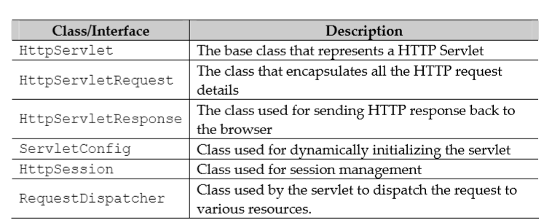
Servlet API
Though there are several classes and interfaces in this API. Some of the most important are shown in table :

Slide 13
Deployment Descriptor
A deployment descriptor is a standard XML file named web.xml that is used by the web container to run the web applications.
Every web application will have one and only one deployment descriptor (web.xml file). This file defines the following important information pertaining to a Servlet:
  Servlet name and Servlet class
  The URL mapping used to access the Servlet
Let’s assume we wrote a servlet named FormProcesssingServlet in a package named myservlets. The definition for this servlet in the web.xml will be as shown below:
<servlet>
<servlet-name>FormProcessingServlet</servlet-name>
<servlet-class>myservlets.FormProcessingServlet</servlet-class>
</servlet>

Slide 14
The servlet name can be any arbitrary name, but it’s a good practice to have the class name as the servlet name. However, the servlet class tag must represent the fully qualified name of the servlet which includes the package name as shown above.
The next thing we need to define is the URL mapping which identifies how the servlet is accessed from the browser. For the above servlet, the url mapping will be as shown below:
<servlet-mapping>
<servlet-name>FormProcessingServlet</servlet-name>
<url-pattern>/FormProcessingServlet</url-pattern>
</servlet-mapping>
If you noticed carefully, the servlet name in both the XML snippets is the same. This is how we bind the url mapping with a servlet. The url pattern defines how the servlet will be accessed. With the above mapping, the FormProcessingServlet should be accessed with the following URL:
  http://localhost:8080/myweb/FormProcessingServlet
The web container then delegates the request to myservlets.FormProcessing Servlet class to process the request.

Slide 15
Steps for Writing a Servlet
Writing a servlet is very simple.
You just have to follow a standard process as shown below:
  Create a class that extends HttpServlet
  Define 3 methods namely init(), doGet() and doPost().
These three methods are the standard methods for any servlet. These are called as callback methods that the web container invokes automatically when a HTTP request comes to this servlet.
For all the GET requests, the web container invokes the doGet() method, and for POST requests it invokes the doPost() method.

Slide 16
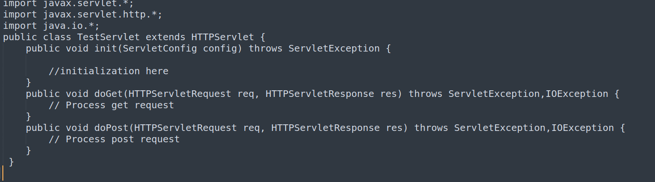

Slide 17
If you look at the above servlet, it does the following things
  Imports all the servlet classes
  The class extends HttpServlet
  Defined 3 methods init(),doGet() and doPost()

Slide 18
LifeCycle of a Servlet
The life cycle of a servlet represents how the web container uses the servlet to process the requests. Following is what a web container does with a servlet:
  Loads the Servlet
  Instantiates the Servlet
  Initializes the servlet by executing the init() method.
  Invokes the doGet() or doPost() methods to process the requests.
  Repeats Step 4 until all the requests are processed
  Destroy the servlet

Slide 19
import javax.servlet.*;
import javax.servlet.http.*;
import java.io.*;
public class GreetingServlet extends HttpServlet {
public void doGet(HttpServletRequest req, HttpServletResponse res) throws ServletException, IOException {
res.setContentType("text/html");
PrintWriter pw = res.getWriter();
// Send the message
pw.println("<h1>Welcome to Servlets </h1>");
}
}

Slide 20
This is a simple servlet which defined just the doGet() method since we will only send a request from the browser which is a GET request.
This method takes two arguments namely HttpServletRequest and HttpServletResponse.
The former is used to read the data from the request and the later is used to send the response back to the browser.
In this example we only use the response object to send a greeting message to the browser.
To send a response, we need to do three things as outlined below:

Slide 21
Define the type of the response data. This is done using the following statement:
  res.setContentType("text/html");
The above line specifies that we are sending HTML response back.
Open a stream/channel to the browser to send the response. This is done using the following statement:
  PrintWriter pw = res.getWriter();
Send the html message to the browser. To send response message to the browser, we use the println() method as shown below:
  pw.println("<h1>Welcome to Servlets </h1>");

Slide 22
Servlet Initialization
Initializing a servlet is one of the most common practices.
Servlet initialization is done in the init() method of the servlet.
Defining initialization parameters for servlets in web.xml is a good practice as it eliminates hard coding in the servlet.
The web container while loading the servlet, invokes the init() method of the servlet as part of the life cycle and passes the parameters defined in the web.xml to it.
The other advantage with this is, in the future if the initialization values need to be changed, you only have to change the web.xml without having to recompile the entire web application.
Initialization parameters to a servlet are defined in the web.xml using the <init-param> element as shown below:
<init-param>
<param-name>driver</param-name>
<param-value>com.mysql.jdbc.Driver</param-value>
</init-param>

Slide 23
With the above definition, a servlet can access the parameter in the init() method as shown below:
public void init(ServletConfig config){
String drivername = config.getInitParameter(“driver”);
}
As you can see from the above code, the ServletConfig class defines a method named getInitParameter() that takes the name of the initialization parameter defined in the web.xml for that servlet, and returns the value.
Therefore drivername will be initialized with com.mysql.jdbc.Driver.
As you can see from the above code, the ServletConfig class defines a method named getInitParameter() that takes the name of the initialization parameter defined in the web.xml for that servlet, and returns the value.

Slide 24
Reading HTML Form Data
HTML form processing is one of the most common things that any web application does.
On various websites user fill in html form with all the information and submit it for processing.
The application then responds with a confirmation message something like “information is successfully processed”.
Following are the steps for processing a HTML form using a Servlet
  User fills the data in the html page and submits it.
  The form data will then be sent to Servlet
  Servlet reads the form data, processes it and send a confirmation.

Slide 25
Session Management
The examples we saw until now just deal with one servlet. However, a typical web application comprises of several servlets that require collaborating with each other to give a complete response.
For instance, if you go online to purchase a book, you need to go through multiple pages like search page, shopping page, billing page etc before you can complete the transaction.
In situations like this, it is important that one servlet shares information or data with other servlet.
In web application terminology we call the shared data or information as state. Having state is just not sufficient. Someone must be able to pass this state from one servlet to another servlet so that they can share the data.

Slide 26
A web container provides a common storage area called as session which store the state and provides access to this session to all the servlets within the web application.
For instance, servlet A can create some state (information) and store it in the session. Servlet B can then get hold of the session and read the state.
Since the state (data or information) in the session is user specific, the web container maintains a separate session for each and every user as shown in the following diagram.

Slide 27
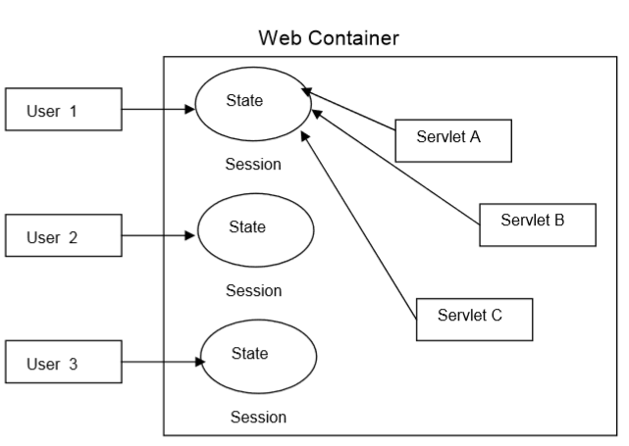

Slide 28
If you look at the above figure, every user will have his own session object for storing the state pertaining to his transaction and all the servlets will have access to the same session. Also notice, the session objects are present within the container.
Now that we know what a session is, let’s see how a servlet uses the session for sharing the data across multiple pages in a web application. A servlet can do the following four most important operations to work with sessions.
  Create the session
  Store the data in the session
  Read the data from the session
  Destroy the session or invalidate the session.
The above four operations are called as Session Management operations.

Slide 29
Creating a Session
The servlet API provides us with a class called HttpSession to work with sessions. To create a session, we do the following:
  HttpSession session = request.getSession();
The above method returns a new session object if one is not present, otherwise it returns the old session object that is already created before.

Slide 30
Storing the data in Session
Data in session is stored as key-value pair just like in HashMap or Hashtable. The value can be any Java object and the key is usually a String. To store the data we use the setAttribute() method as shown below:
  session.setAttribute(“price”,new Double(“12.45”));

Slide 31
Reading the data from the Session
To read the data, we need to use the getAttribute() method by passing in the key as shown below which then returns the value object:
  Double d = (Double)session.getAttribute(“price”);

Slide 32
Destroying the Session
A session is usually destroyed by the last page or servlet in the web application. A session is destroyed by invoking the invalidate() method as shown below:
  session.invalidate();

Slide 33
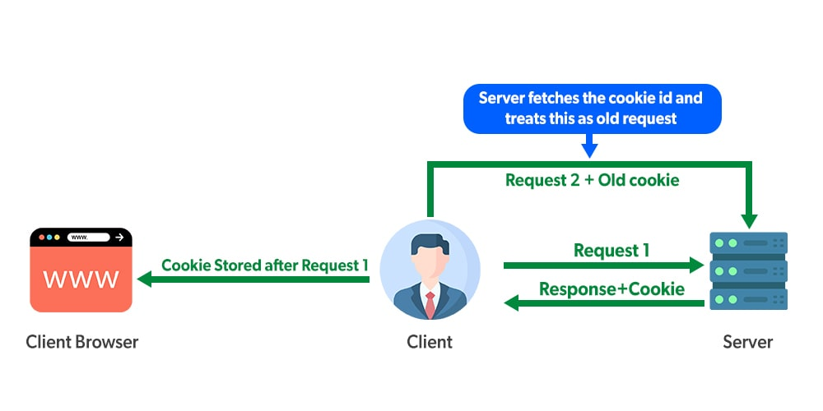
Cookies

Slide 34
Cookies are the textual information that is stored in key-value pair format to the client’s browser during multiple requests.

Slide 35
<form action="hello" method="post">
Name:<input type="text" name="userName"/><br/>
<input type="submit" value="go"/>
</form>

Slide 36
public class FirstServlet extends HttpServlet {
public void doPost(HttpServletRequest request, HttpServletResponse response){
response.setContentType("text/html");
PrintWriter out = response.getWriter();
String n=request.getParameter("userName");
out.print("Welcome "+n);
Cookie ck=new Cookie("uname",n);
response.addCookie(ck); out.print("<form action='servlet2'>");
out.print("<input type='submit' value='go'>");
out.print("</form>");
out.close();
}

Slide 37
public class SecondServlet extends HttpServlet {
public void doPost(HttpServletRequest request, HttpServletResponse response){
response.setContentType("text/html");
PrintWriter out = response.getWriter();
Cookie ck[]=request.getCookies();
out.print("Hello "+ck[0].getValue());
out.close();
}
}

Slide 38
Request Dispatching
Request dispatching is the ability of one servlet to dispatch or delegate the request to another servlet for processing.
In simple words, let's say we have a servlet A which doesn't know how to completely process the request. Therefore, after partially processing the request, it should forward the request to another servlet B. This servlet then does the rest of the processing and sends the final response back to the browser.
The class used for dispatching requests is the RequestDispatcher interface in Servlet API. This interface has two methods namely forward() and include().

Slide 39
The forward() method
This method is used for forwarding request from one servlet to another.
Consider two servlets A and B. Using this method, A gets the request, which then forwards the request to B, B processes the request and sends the response to the browser.
This method takes HttpServletRequest and HttpServletResponse as parameters.
  RequestDispatcher rd = req.getRequestDispatcher("shop.html");
  rd.forward(req, res);

Slide 40
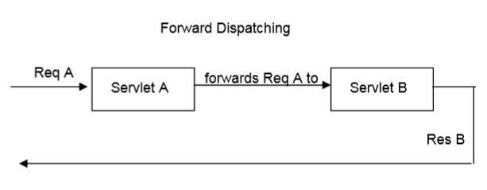

Slide 41
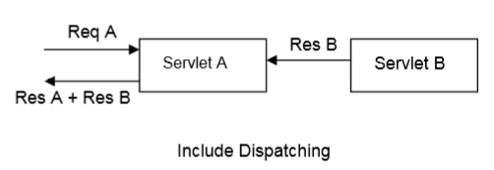
The include() method
With this method, one servlet can include the response of other servlet. The first servlet will then send the combined response back to the browser.
This method also takes HttpServletRequest and HttpServletResponse as parameters.
  RequestDispatcher rd=req.getRequestDispatcher("BannerServlet");
  rd.include(req, res);

Slide 42
JSP
Java Server Page

Slide 43
JSP Basics
A typical JSP page very much looks like html page with all the html markup except that you also see Java code in it. So, in essence,
  HTML + Java = JSP
Therefore, JSP content is a mixed content, with a mixture of HTML and Java.
A html file will only have html markup, and a jsp file will have both html markup and Java code.

Slide 44
JSP is a server side technology which is used for creating web application.
It is used to create dynamic web content.
JSP tags are used to insert JAVA code into HTML pages.
It is an advanced version of Servlet Technology.
In JSP, Java code can be inserted in HTML/ XML pages or both.
JSP is first converted into servlet by JSP container before processing the client’s request.

Slide 45
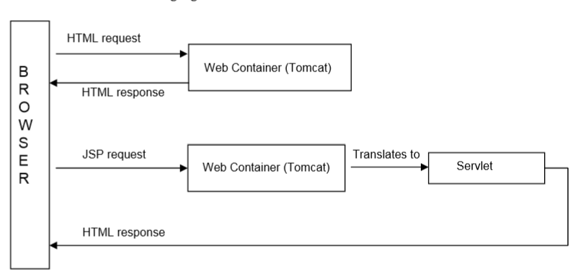

Slide 46
When the browser requests for html file, the web container simply responds with a html response without any processing.
However, when the browser sends a JSP page request, the web container assumes that the JSP page might include Java code, and translates the page into a Servlet.
The servlet then processes the Java code, and returns the complete html response including the dynamic content generated by the Java code.
Though the web container does the translation of JSP to Servlet, we need to know how it does this translation.
For a web container to translate JSP, it needs to identify from the JSP page, as to which is HTML markup and which is Java code.
According to J2EE specification, a JSP page must use special symbols as placeholders for Java code.

Slide 47
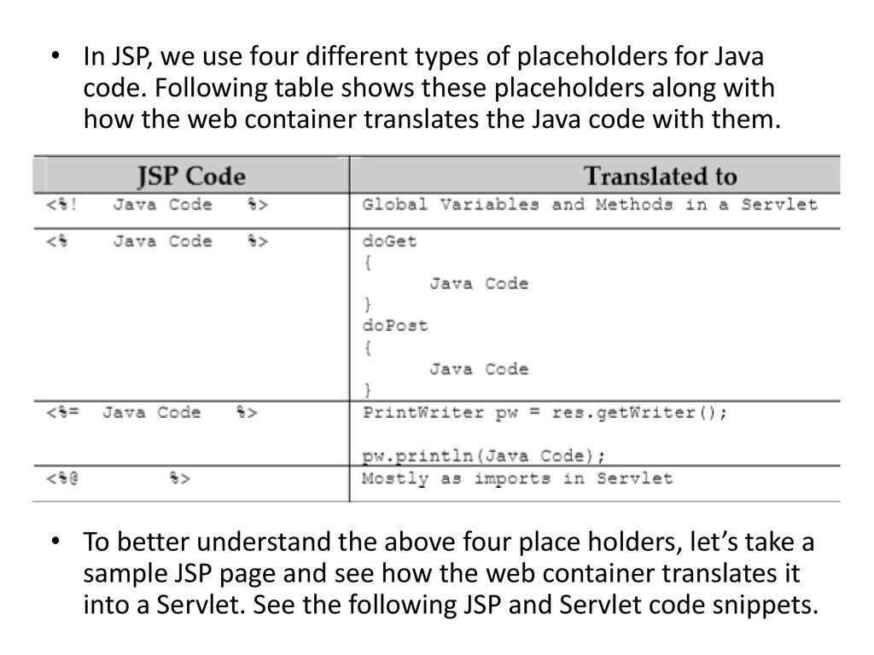

Slide 48
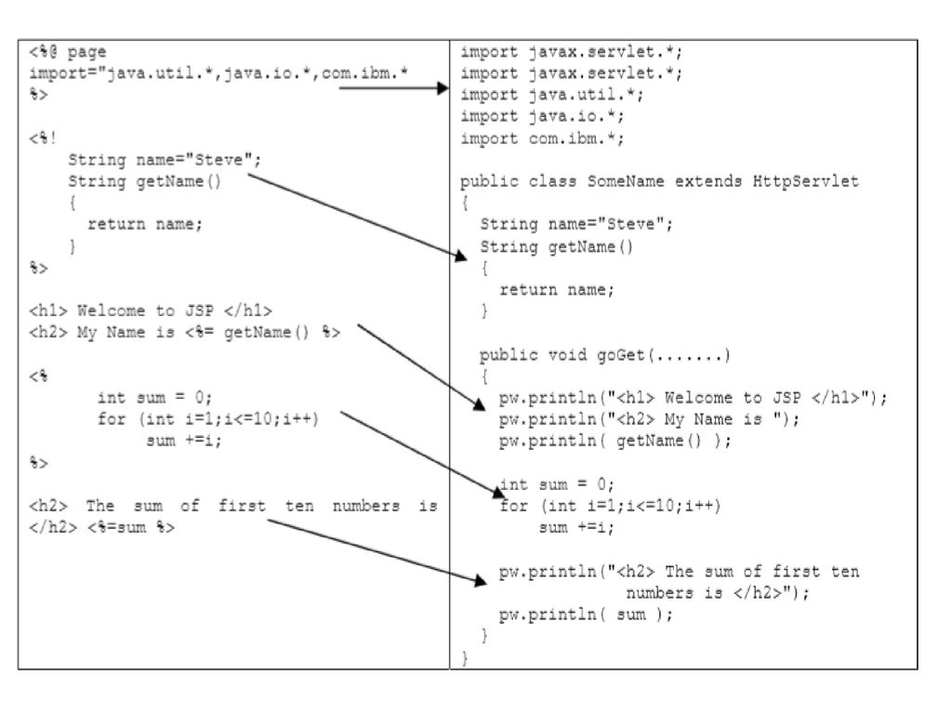

Slide 49
JSP Scripting
The scripting elements provides the ability to insert java code inside the jsp.
There are three types of scripting elements:
  scriptlet tag
  expression tag
  declaration tag

Slide 50
JSP scriptlet tag
A Scriptlet is a piece of Java code that represents processing logic to generate the dynamic content wherever needed in the page.
Syntax is as follows:
<% java source code %>
Example:
<html>
<body>
<%
int a=10; int b=20; int c=30;
out.println(a+b+c);
%>
</body>
</html>

Slide 51
JSP Expression Tag
The code placed within JSP expression tag is written to the output stream of the response.
So you need not write out.print() to write data.
It is mainly used to print the values of variable or method.
Syntax
<%= statement %>
Example:
<html>
<body>
<%= "welcome to jsp" %>
</body>
</html>

Slide 52
JSP Declaration Tag
The JSP declaration tag is used to declare fields and methods.
The code written inside the jsp declaration tag is placed outside the service() method of auto generated servlet.
Syntax:
<%! Java code %>
Example:
<html>
<body>
<%! int data=50; %>
<%= "Value of the variable is:"+data %>
</body>
</html>

Slide 53
JSP Directives
Directives are used for declaring classes, session usage etc., and does not produce any response to the client.
Syntax:
<%@ Java code %>
A directive uses attributes for declarations. There are 3 types of directives as listed below:
  page directive
  include directive
  taglib directive

Slide 54
The Page Directive
This directive is used to declare things that are important to the entire JSP page.
The syntax for this directive is shown below
  <%@ page attribute list %>

Slide 55
Attribute List
import
contentType
extends
info
isThreadSafe
session
pageEncoding
errorPage
isErrorPage

Slide 56
1)import
The import attribute is used to import class,interface or all the members of a package.It is similar to import keyword in java class or interface.
Example:
<%@ page import="java.util.Date" %>
Today is: <%= new Date() %>
2) contentType
The contentType attribute defines the MIME(Multipurpose Internet Mail Extension) type of the HTTP response.
Example:
<%@ page contentType=application/msword %>
Today is: <%= new java.util.Date() %>

Slide 57
3)info
This attribute simply sets the information of the JSP page which is retrieved later by using getServletInfo() method of Servlet interface
<%@ page info="composed by Sudip" %>
Today is: <%= new java.util.Date() %>
4)buffer
The buffer attribute sets the buffer size in kilobytes to handle output generated by the JSP page.The default size of the buffer is 8Kb.
<%@ page buffer="16kb" %>
Today is: <%= new java.util.Date() %>

Slide 58
5)errorPage
The errorPage attribute is used to define the error page, if exception occurs in the current page, it will be redirected to the error page.
<%@ page errorPage="myerrorpage.jsp" %>
<%= 100/0 %>
6)isErrorPage
The isErrorPage attribute is used to declare that the current page is the error page.
<%@ page isErrorPage=true %>
Sorry an exception occured!<br/>
The exception is: <%= exception %>

Slide 59
Include Directive
This directive is used to include the response of another resource (JSP or html) at the point where the directive is placed in the current JSP. Its usage is shown below.
syntax: <%@ include file=”file name” %>
Example:

Slide 60
<HTML>
<BODY>
<h4> This is the response from the current JSP page</h4>
<h3> Following is the response from another JSP </h3>
<hr/>
<%@ include file=”/jsps/PageDirectiveDemo.jsp” %>
<hr/>
</BODY>
</HTML>

Slide 61
The taglib directive
This directive allows the JSP page to use custom tags written in Java.
Custom tag definitions are usually defined in a separate file called as Tag Library Descriptor.
For the current JSP to use a custom tag, it needs to import the tag library file which is why this directive is used. Following is how taglib directive is used.
  <%@ taglib uri=”location of definition file” prefix=”prefix name” %>

Slide 62
<html>
<body>
<%@ taglib uri = “./location/tags” prefix=”mytag”%>
<mytag:currentDate/>
</body>
</html>

Slide 63
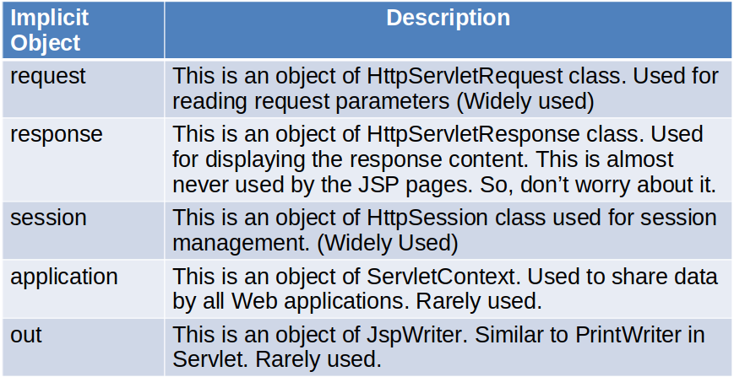
Implicit Objects
As the name suggests every JSP page has some implicit objects that it can use without even declaring them.

